Slide 1
Stock Price Market Prediction
Using Python and Machine Learning Model

Slide 2
Summary
Purpose
Question
DataSource
The purpose of this project is to create interactive dashboard that helps with stock price prediction using linear regression machine learning model.
- What is the expected value of the customers' stocks based on their portfolio in the future? (prediction)
- What is the future value of the customers' stocks based on their current portfolio?
- Data is gathered from yahoo finance
-This interactive dashboad helps with Stock Price Prediction. This dashboard has been created using SP500 historical data obtained

Slide 3
Implementation

Slide 4
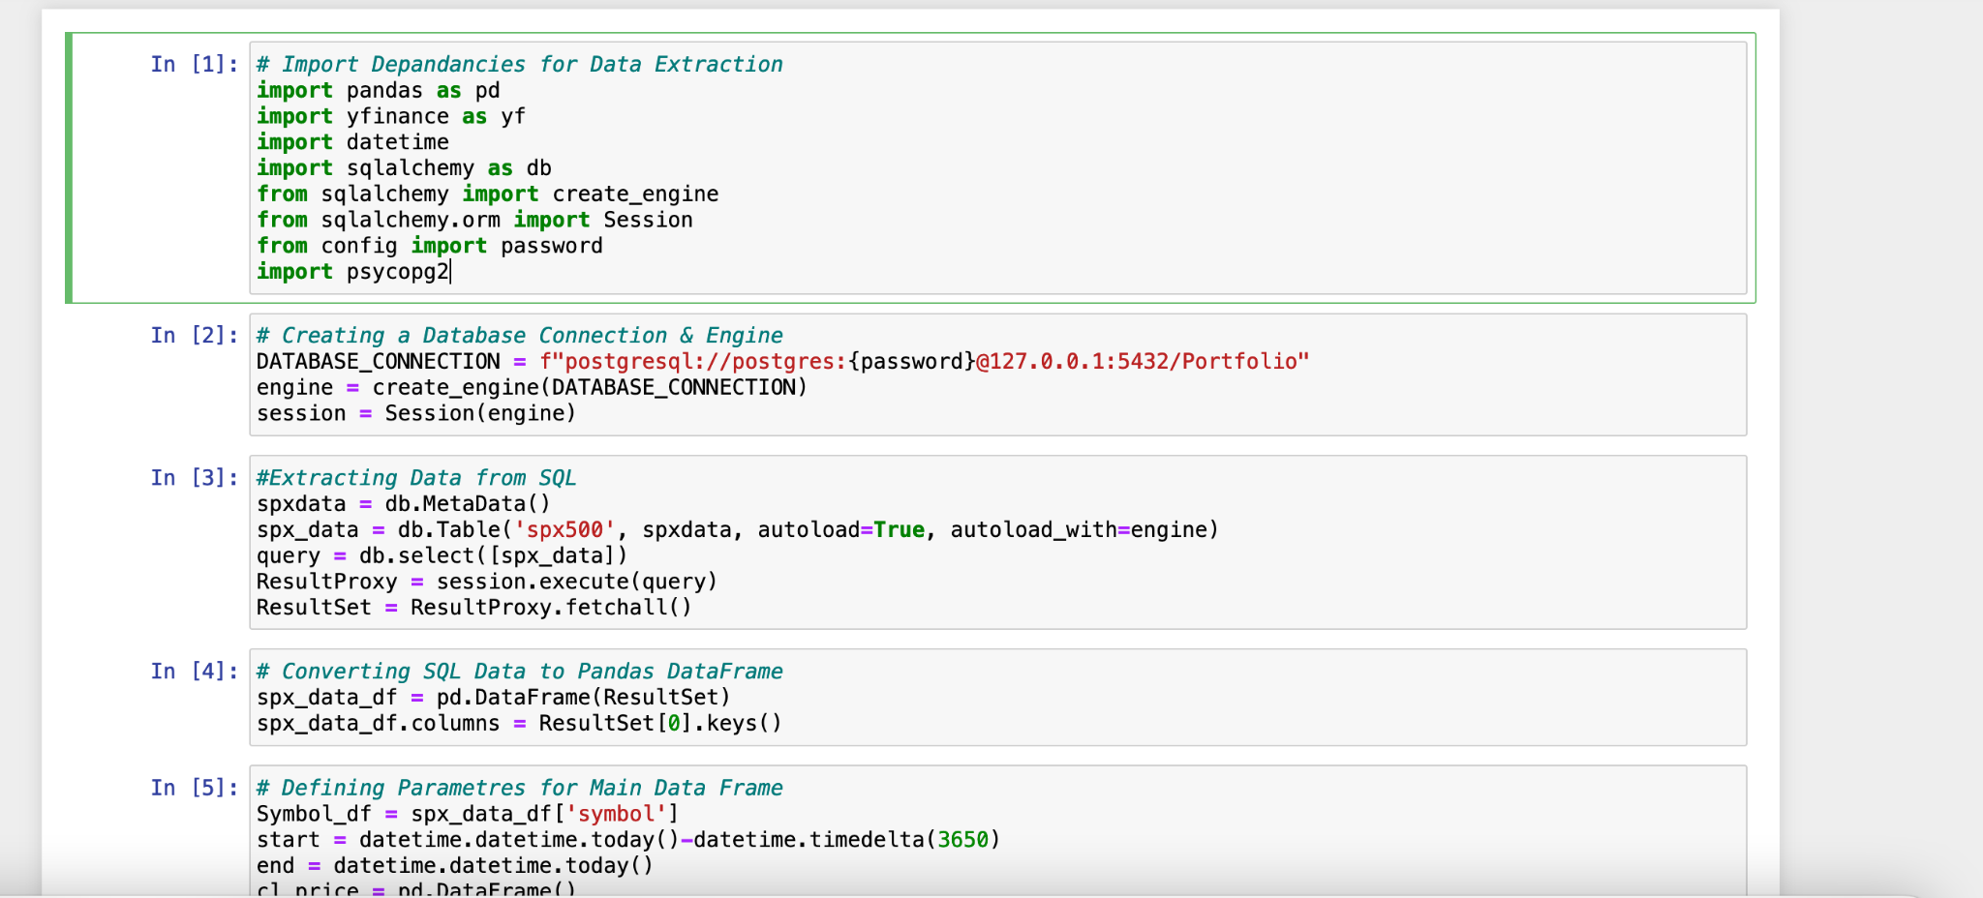
Fig 1 below shows the snapshot of the process to import the dependencies for the data extraction from Yahoo Finance to the PostgreSQL database.

Slide 5
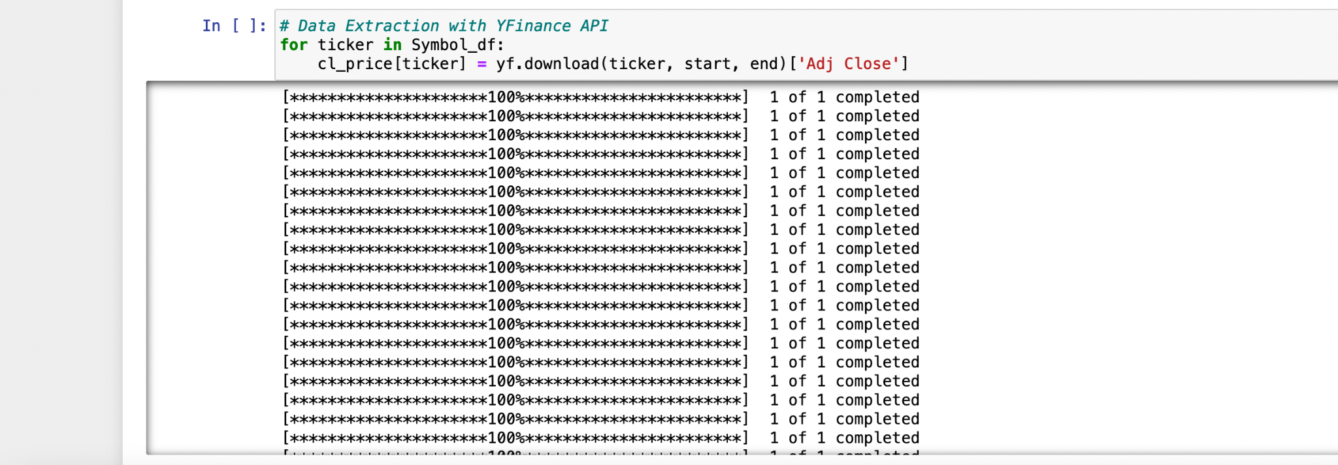
Fig 2 below shows the snapshot of the process to extract data using Yfinance API

Slide 6
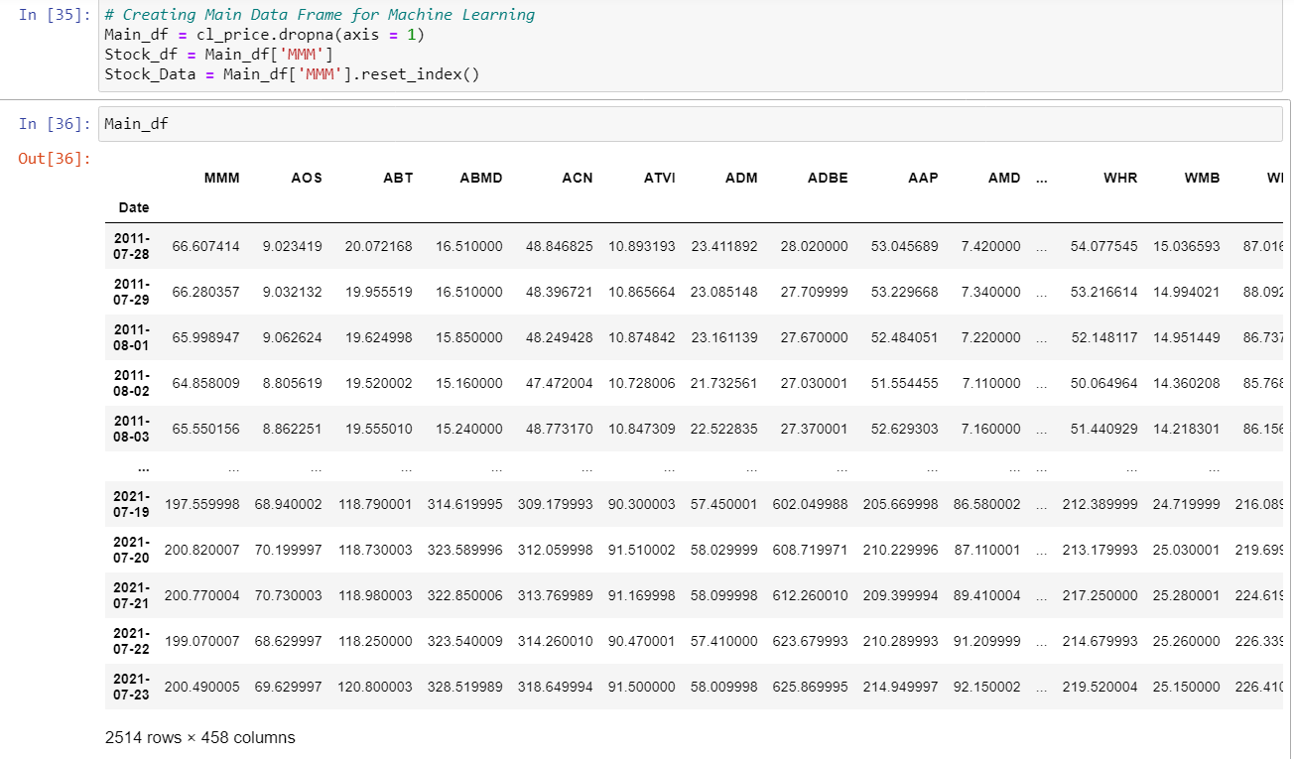
Fig 3 below shows the snapshot of dataframe extracted for machine learning

Slide 7
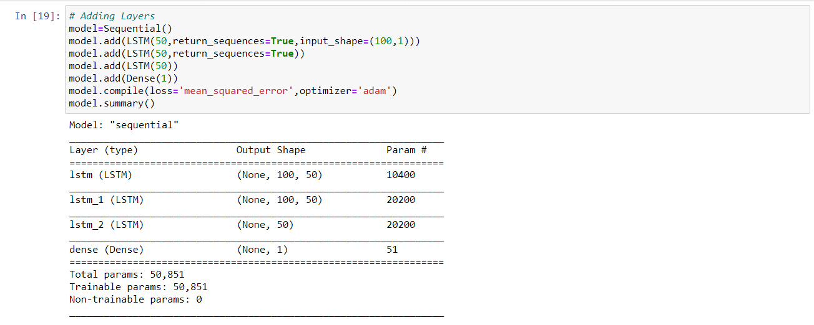
Fig 4 below shows the snapshot of the process to improve accuracy of data

Slide 8
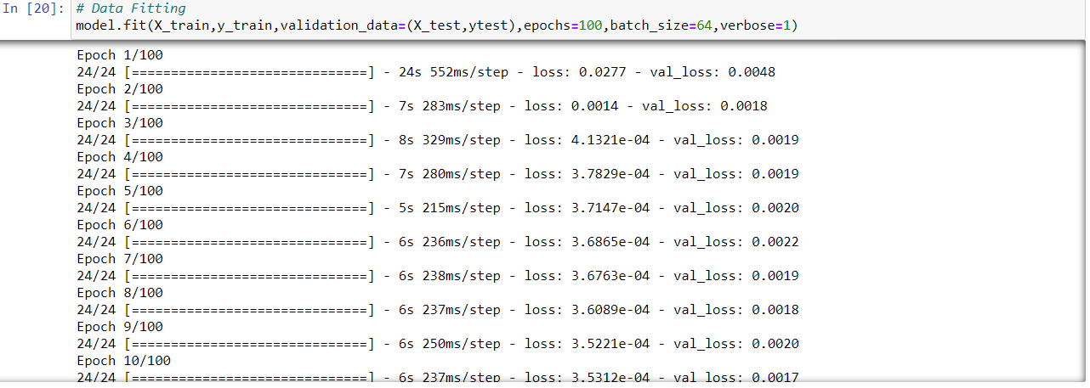
Fig 5 The image below shows the data fit using train and test model

Slide 9
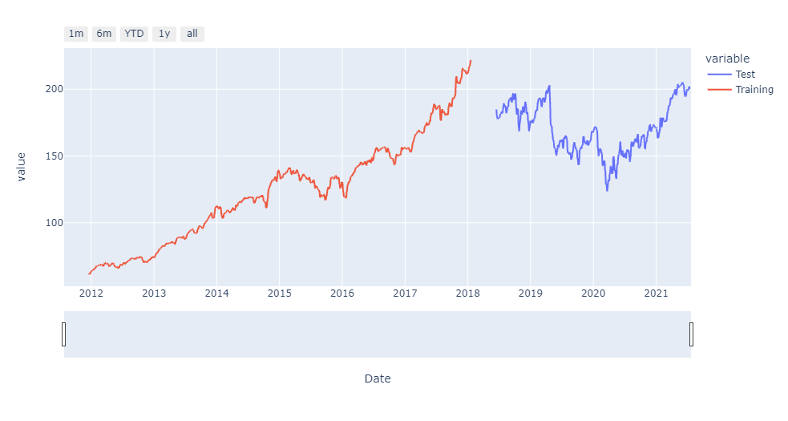
Fig 6 The image below shows for the testing vs. training data with sample data

Slide 10
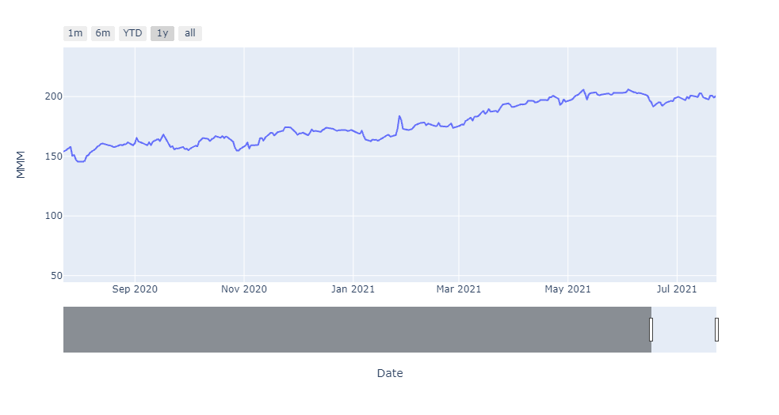
Fig 7 The image below only shows the current stock price for the 3M (MMM) stocks

Slide 11
Data Visualization

Slide 12
Dashboard
The tools we are using to make the dashboard interactive:
Dash
Plotly
Python (py)
Heroku app
Tools

Slide 13
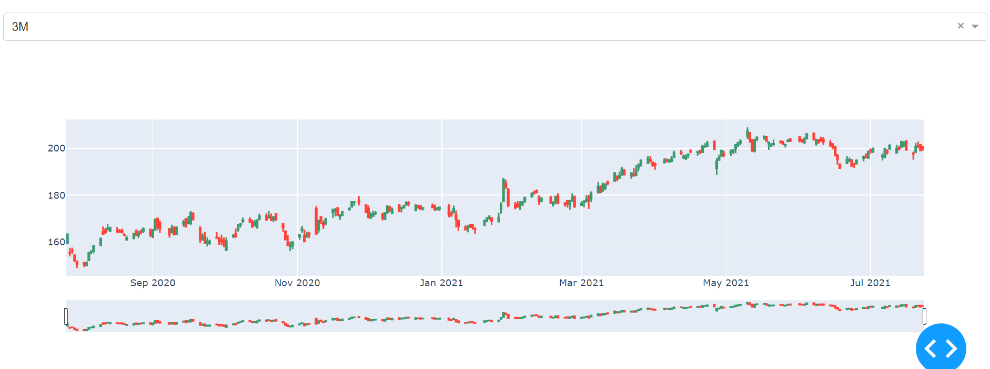
Below is the image of sample stock MMM that interactive dashboard created for client to predict the growth of portfolio

Slide 14
Link for herokuapp
max growth
Final Deployment
https://dashboard.heroku.com/apps/predictstockapp/deploy/github

